Slide 1
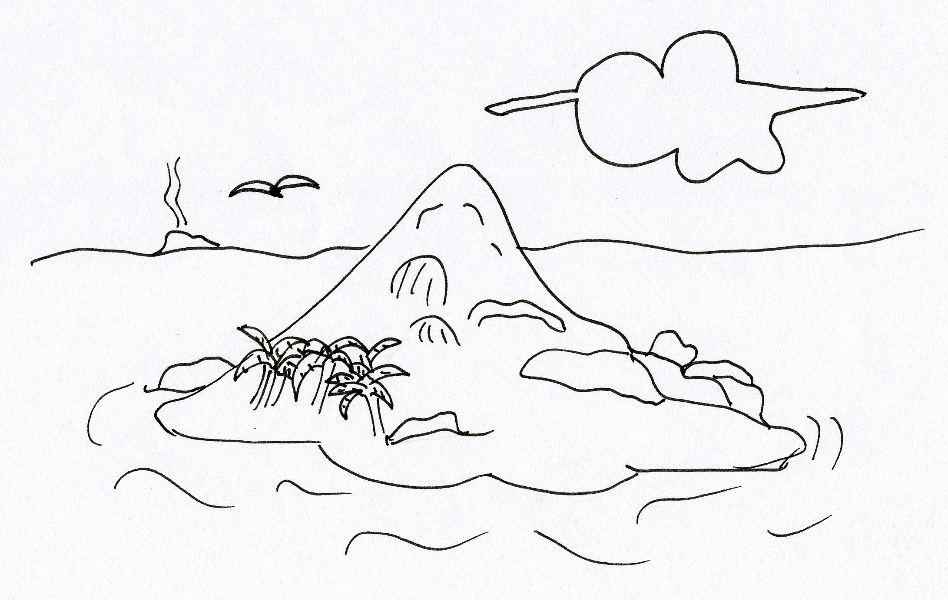
500
200
Ecos
Ecos
50
20
Ecos
Ecos

Slide 2
100
10
Ecos
Ecos
50
20
Ecos
Ecos

